Slide 1

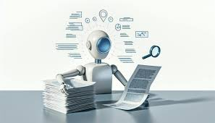
Scientific Research Paper Summarization System
Please Click Here to access : Video Presentation
Bibek Shiwakoti (C0898100)
Guneet Singh (C0882945)
Jumana Lightwala (C0892358)
Pratikkumar Mishra (C0891298)
Ronak Shah (C0891297)

Slide 2
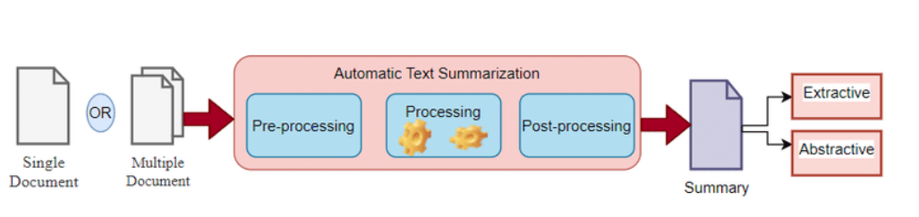
MAIN OBJECTIVE
Develop an AI system to extract and condense key information from scientific papers, allowing researchers to quickly grasp crucial findings

Slide 3
Overview -
Overcoming the Challenge of Information Overload in Scientific Research
Problem: The rapid growth of scientific literature hinders researchers from staying updated.
Solution: Developed an AI-powered summarization system using NLP, LLMs, and LangChain.
Approach: Fine-tuned BART-large-CNN model on arXiv dataset for effective summarization.
Benefits: Significantly reduces time spent on literature review and enables researchers to focus on innovation.
Future: Aims to integrate with real-time publication platforms for instant summarization of new research.

Slide 4
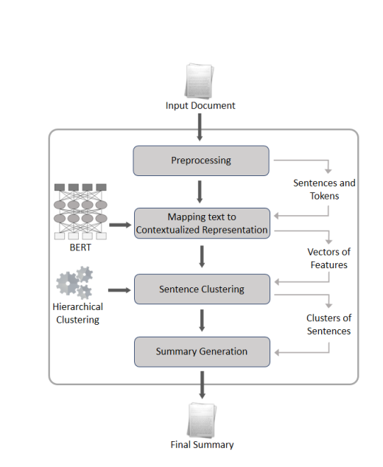
System Architecture:
System Overview -
Input: System processes PDF or Word documents as input.
Output: Generates a concise summary of the input document.
Process Steps -
Preprocessing
Text Representation
Sentence Grouping
Summary Creation

Slide 5
Preprocessing -
Preprocessing:
Extracts text content.
Cleans and normalizes text.
Splits text into sentences and words.
Text Representation:
Converts text into numerical embeddings using NLP models (BERT, GPT).
Captures semantic and syntactic information.
Sentence Clustering:
Groups similar sentences based on embeddings.
Identifies key themes and important points.
Summary Generation:
Selects representative sentences from clusters.
Creates a concise and coherent summary.

Slide 6
Tools and Platform Used -
LLM - Large Language Models (LLMs) are AI systems trained on massive amounts of text data to understand and generate human-like text. They can perform tasks like translation, summarization, and question answering.
HuggingFace - Hugging Face is a leading AI company specializing in natural language processing. They offer a platform with a vast collection of pre-trained models, datasets, and tools, making it easy for anyone to build AI applications.

Slide 7
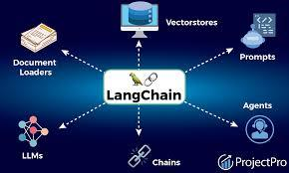
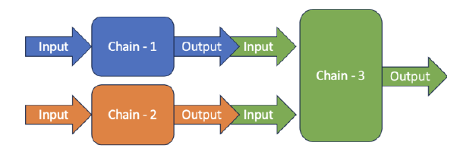
LangChain is a framework that simplifies building applications using large language models (LLMs). It provides tools to integrate LLMs into different projects, making it easier to manage and utilize these powerful models.

Slide 8
Dataset Acquisition and Preparation
Leveraged arXiv Dataset: Utilized a vast collection of scientific papers from arXiv on Hugging Face for training and evaluation.
Data Collection: Gathered research papers from various sources (academic journals, conference proceedings, arXiv) through web scraping, APIs, and partnerships.
Data Cleaning: Removed duplicates, irrelevant content, and incomplete records.
Metadata Enhancement: Added metadata tags (keywords, disciplines, citation counts) for improved analysis.
Data Splitting: Divided dataset into training, validation, and test sets.

Slide 9
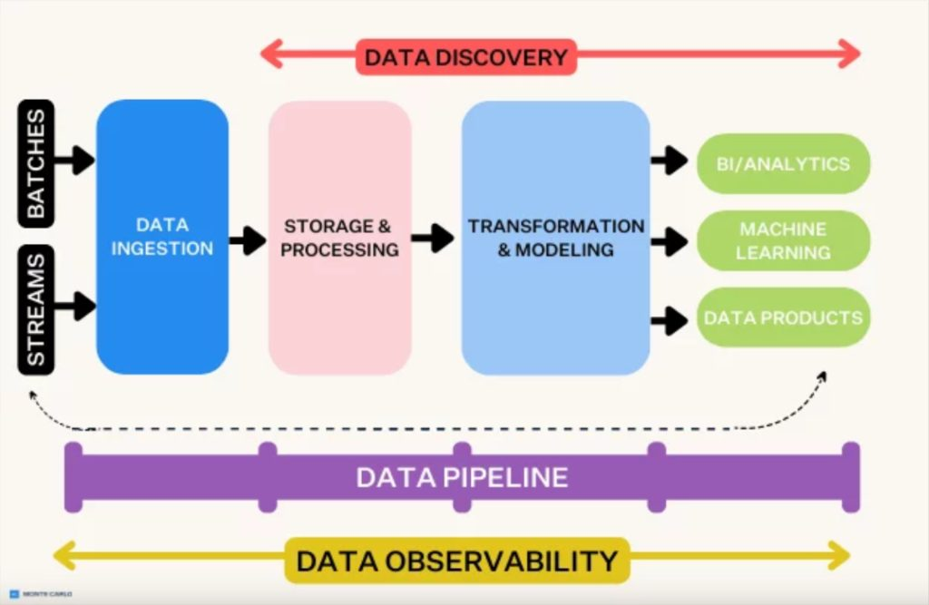
Data Pipeline-

Slide 10
Model Development and Dataset Refinement
Initial Model Training: Developed a baseline summarization model using BERT for extractive summarization. Evaluated performance using ROUGE and BLEU metrics.
Annotated Dataset Creation: Created a high-quality annotated dataset by engaging domain experts and establishing clear annotation guidelines.
Dataset Diversity: Ensured dataset represented various scientific disciplines for model generalizability.

Slide 11
Model Evaluation and Refinement
Model Comparison: Evaluated multiple summarization models (BERT, GPT-2, T5) using ROUGE scores to identify the best performer.
Model Exploration: Tested additional models (t5-small, distilbart-cnn-12-6) from Hugging Face for potential performance improvements.
Data Preprocessing Enhancement: Optimized text preprocessing for better handling of large research papers.

Slide 12
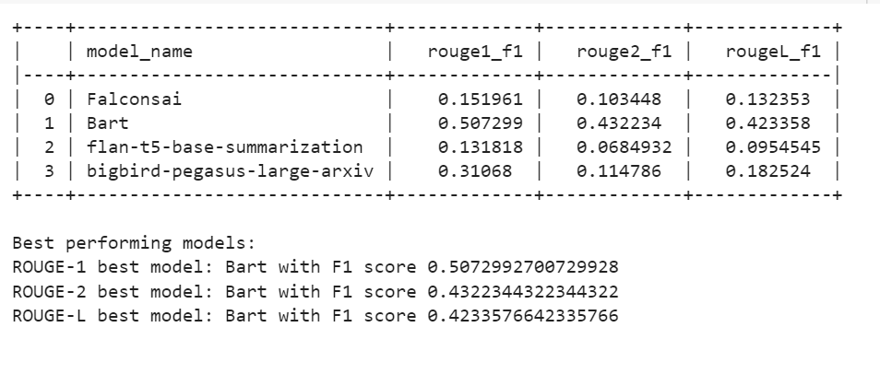
Model selected and used -
Falconsai
Bart
Flan-t5-base-summarization
Bigbird-pegasus-large-arxiv

Slide 13
Model Selection: Utilizes the LaMini-Flan-T5-248M T5 model for summarization tasks.
Tool Integration: Leverages the Transformers library for model interaction, tokenization, and text generation.
Pipeline Creation: Implements an llm_pipeline function to streamline the summarization process.
Model Functionality: The T5 model analyzes input text and generates concise, informative summaries.
We have integrates a pre-trained T5 model into a summarization pipeline using the Transformers library to effectively process and summarize text.

Slide 14
Model Accuracy
Evaluation Metrics: The project will use ROUGE, BLEU, and METEOR metrics to assess model performance.
Human Evaluation: Domain experts will review summaries for relevance and informativeness.
ROUGE Score: A detailed explanation of ROUGE score calculation for n-grams.
Model Comparison: Various models (BART, GPT-2, T5, Falconsai etc.) will be tested using ROUGE scores to determine the best performer.

Slide 15
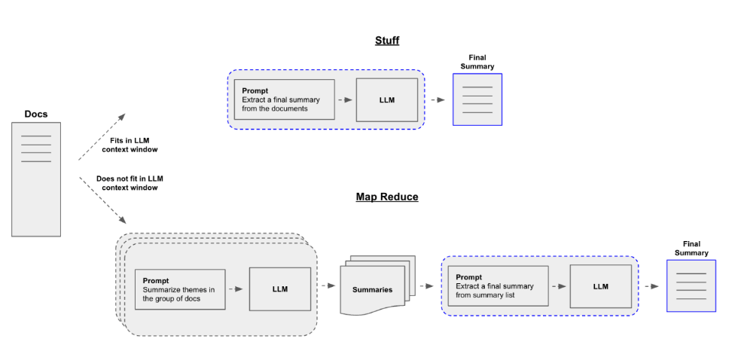

Slide 16
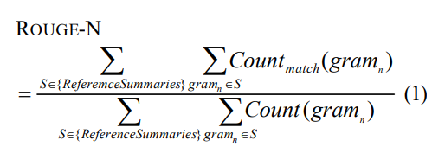
Rouge score -
Rouge calculation formula -
Where n stands for the length of the n-gram, gramn, and Countmatch(gramn) is the maximum number of n-grams co-occurring in a candidate summary and a set of reference summaries.

Slide 17

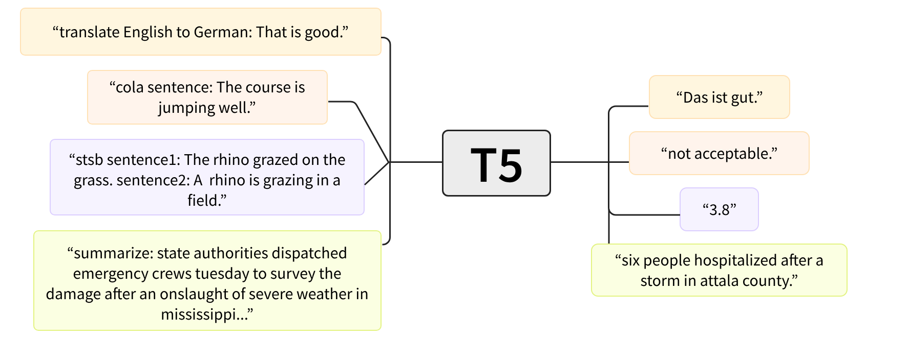
Model accuracy comparison and fine tuning:

Slide 18
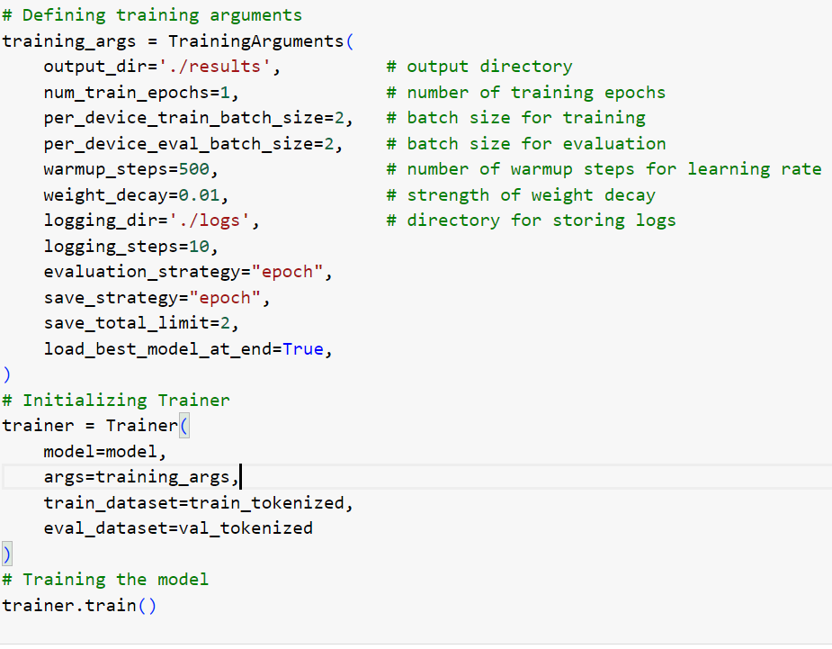
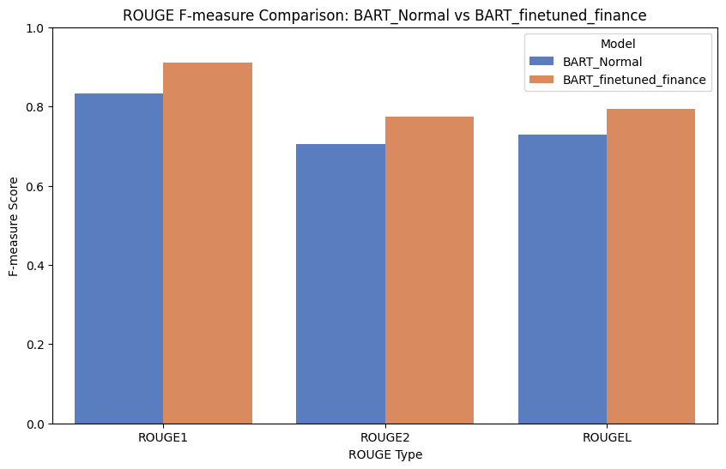
Results -

Slide 19
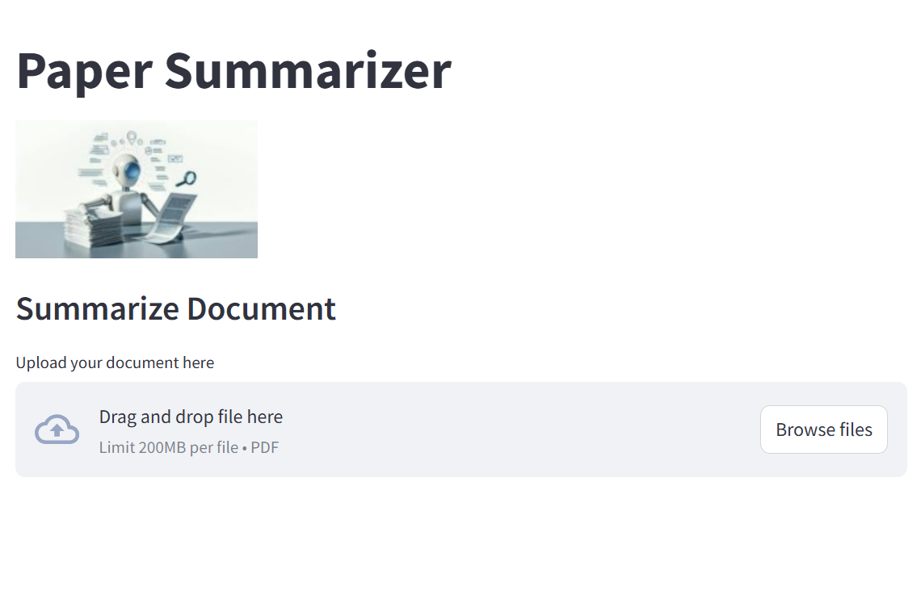
Frontend
Progress bar: Added a visual indicator to track summarization process.
Error handling: Implemented user-friendly error messages for improved user experience.

Slide 20
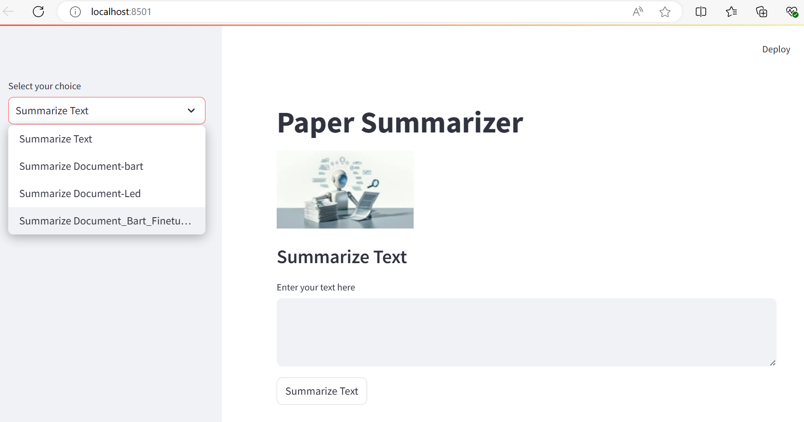
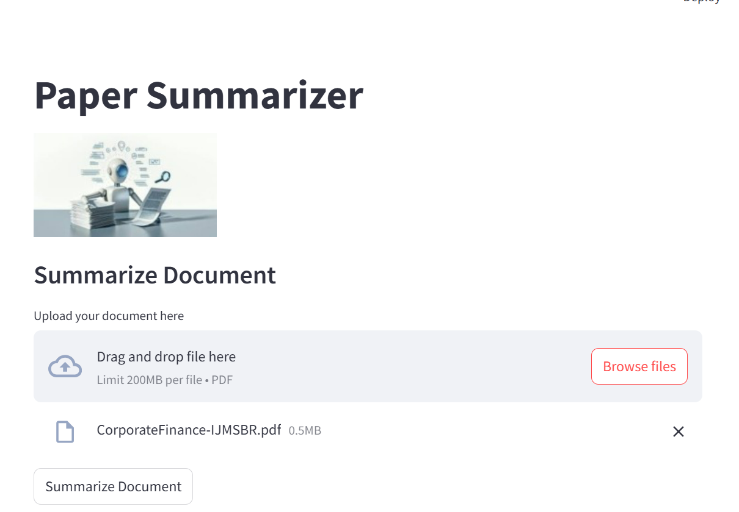
Working -

Slide 21
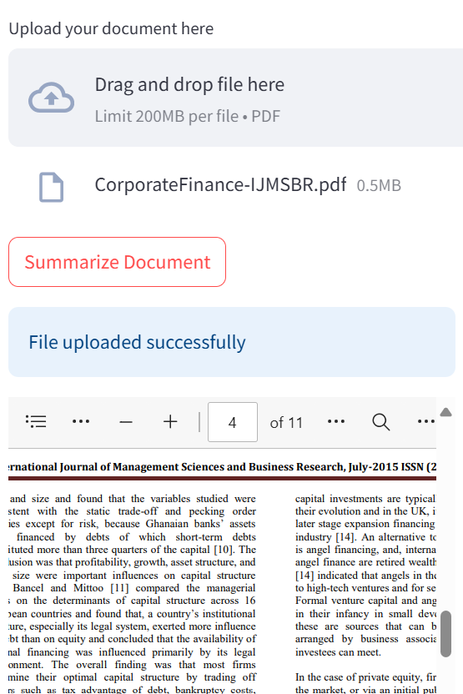
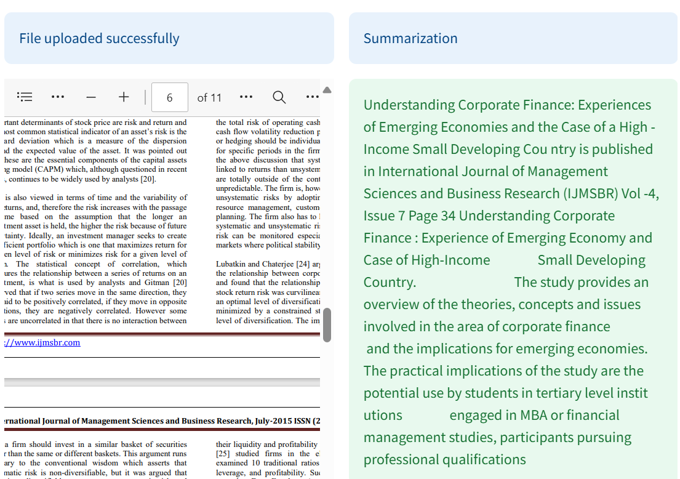

Slide 22
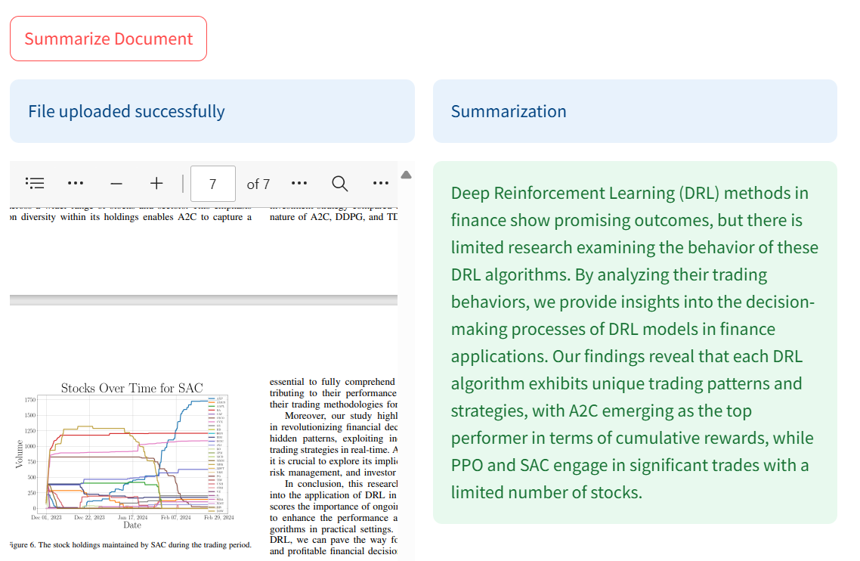
Users can compare original text with its summary and manage uploaded files.

Slide 23
Future work -
Expand Language Support: Add multi-language capabilities to accommodate a wider range of research papers.
Enhance Summarization Quality: Continuously refine the model with diverse datasets and user feedback for improved accuracy.
Real-Time Summarization: Develop features for automatic summarization of newly published papers and conference proceedings.
Integrate Additional Databases: Broaden the system's reach by connecting with more academic databases.

Slide 24
Thank You!!

Slide 25
References
Devlin, J., Chang, M. W., Lee, K., & Toutanova, K. (2018). BERT: Pre-training of deep bidirectional transformers for language understanding. arXiv preprint arXiv:1810.04805.
Ekaterina Zolotareva, Tsegaye Misikir Tashu and Tomáš Horváth , https://ceur-ws.org/Vol-2718/paper28.pdf
Lin, C.-Y. (2004). ROUGE: A package for automatic evaluation of summaries. Information Sciences Institute, University of Southern California.
Liu, P., & Saleh, M. (2021). Text Summarization Techniques: A Brief Survey. arXiv preprint arXiv:2101.00133.
Moradi, M., & Samwald, M. Clustering of Deep Contextualized Representations for Summarization of Biomedical Texts. Institute for Artificial Intelligence and Decision Support, Center for Medical Statistics, Informatics, and Intelligent Systems, Medical University of Vienna, Vienna, Austria.
Sneha Thange, Jayesh Dange, Vivek Karjule, Janhavi Sase, https://www.researchgate.net/publication/375120640_A_Survey_on_Text_Summarization_Techniques

Slide 26
Appendix
Video Presentation Link :
https://drive.google.com/file/d/1UNqInRw4tPQjEZb_h3sjLEs8nfzmvfpD/view?usp=drive_link

